Slide 1


Caffeine for the treatment of apnea of prematurity

Slide 2
Outline
History of caffeine
First uses of methylxanthines for apnea of prematurity
The CAP trial
Physiology of breathing/apnea in prematurity
Mechanism of action of caffeine
Caffeine pharmacokinetics
Summary

Slide 3

Slides prepared by
Dr. Benjamin Courchia MD

Slide 4

The origins of of coffee
Credit: etcoffee.com
Notes:
In the 6th century a goat herder named Kaldi from what is believe to now be modern ethiopia noticed that when his goats were nibbling on the bright red berries of a certain bush, they became very energetic, Kaldi then chewed on the fruit himself. His exhilaration prompted him to bring the berries to the nearest place of worship in the village. After a brief explanation, the head Monk deemed the berries to be the “Devil’s work,” and abruptly threw the berries into a nearby fire. Soon thereafter, a sensual and powerful aroma filled the room that could not be overlooked. The head monk, whom had thrown them in the fire in the first place, ordered the embers be pulled from the fire and for hot water to be poured over them to preserve the smell. Upon drinking the mixture, they experienced the peaceful, warming, and calming sensation it gave them. The after-effects were just as powerful, as they were able to stay alert and discuss important matters for longer periods of time. The monk then shared his discovery with the other monks at the monastery, and knowledge of the energizing berries began to spread.
https://www.ncausa.org/about-coffee/history-of-coffee

Slide 5
The FDA has approved the use of caffeine for the treatment of apnea of prematurity and prevention and treatment of bronchopulmonary dysplasia in premature infants.
Notes:
Caffeine is one of the most commonly uses psychoactive substances in the world, and has been studied extensively in animal models for its neurobehavioral effects. The FDA has approved caffeine for use in the treatment of apnea of prematurity and prevention and treatment of bronchopulmonary dysplasia of premature infants. Non-FDA-approved uses of caffeine include treating migraine headaches and post-dural puncture headaches and enhancing athletic performance, especially in endurance sports. Caffeine has links with decreased all-cause mortality. It is also under investigation for its efficacy in treating depression and neurocognitive declines, such as those seen in Alzheimer and Parkinson disease.

Slide 6
Apnea of prematurity was originally managed supportively. Using stimulation, oxygen, and mechanical ventilation
Notes:
Clinicians were frustrated by this pathology because of its recurrent pattern and unpredictable onset.

Slide 7
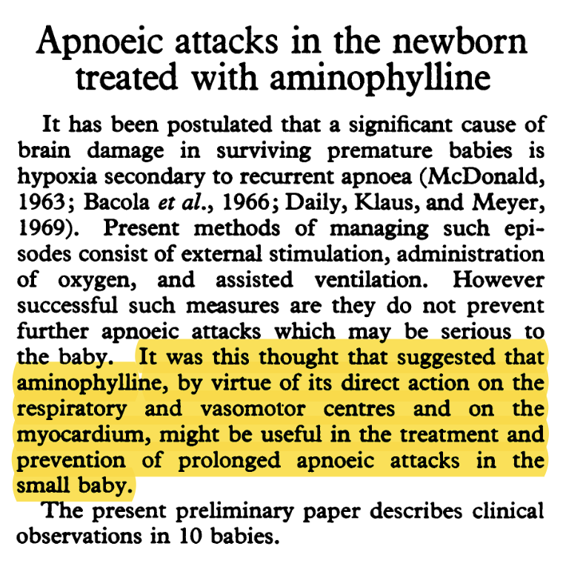
Kuzemko et al. 1973
Notes:
So the first traces of caffeine for the management of apnea of prematurity date back to a paper published in 1973 in the archives of disease and childhood. The first author was Dr. Jan Kuzemko, a polish physician who was smuggled out of the iron curtain in the 1940’s to reach the UK where he studied medicine and became a pediatrician.
In this paper Jan Kuzemko postulates that using aminophylline could a reasonable choice to treat apnea of prematurity. His idea was that aminophylline’s action on the respiratory and vasomotor centers and on the myocardium of the neonate might be both useful treatment and preventive agent for neonatal apnea. So he tried the medication on 10 babies w RDS.
Aminophylline was administered as a suppository at an empirical dose of 5mg

Slide 8
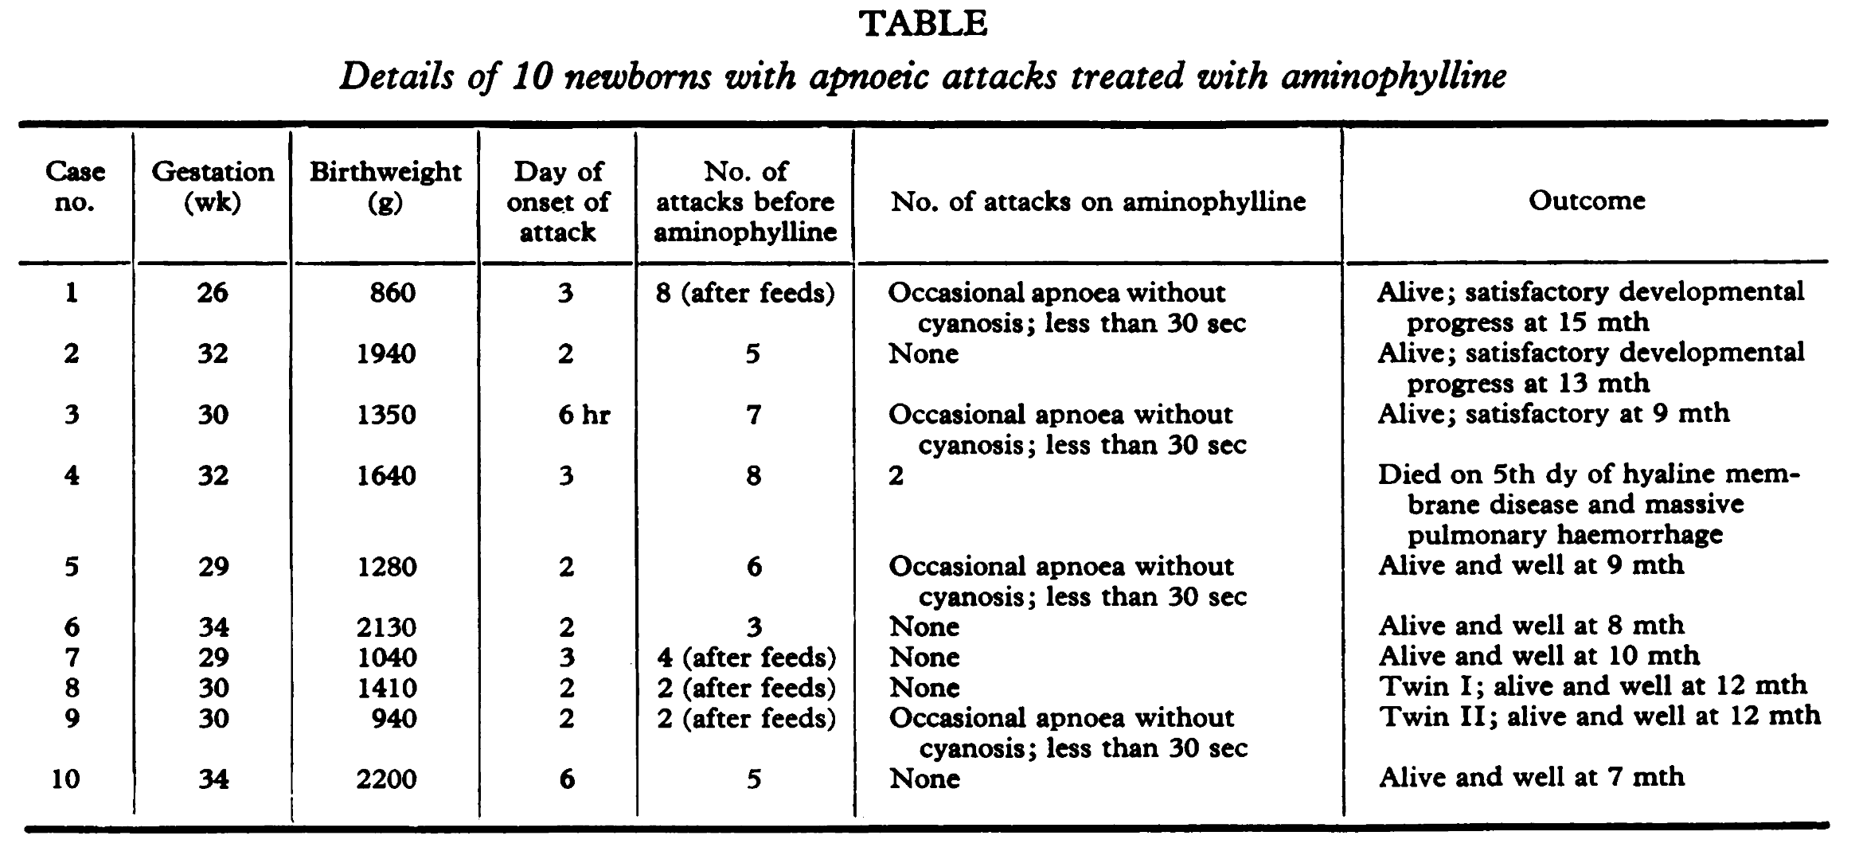
Kuzemko et al. 1973
Notes:
So they gave aminophylline to 10 babies whose gestational age ranged from 26 weeks to 34 weeks and with surprisingly low birthweight for the time: 860g to 2200g. The result of this study was that babies on aminophylline had significantly less episodes of apnea and were much more stable clinically as a result. Even if one of the study subjects passed away, an unfortunate event that was not deemed to be due to aminophylline use.

Slide 9
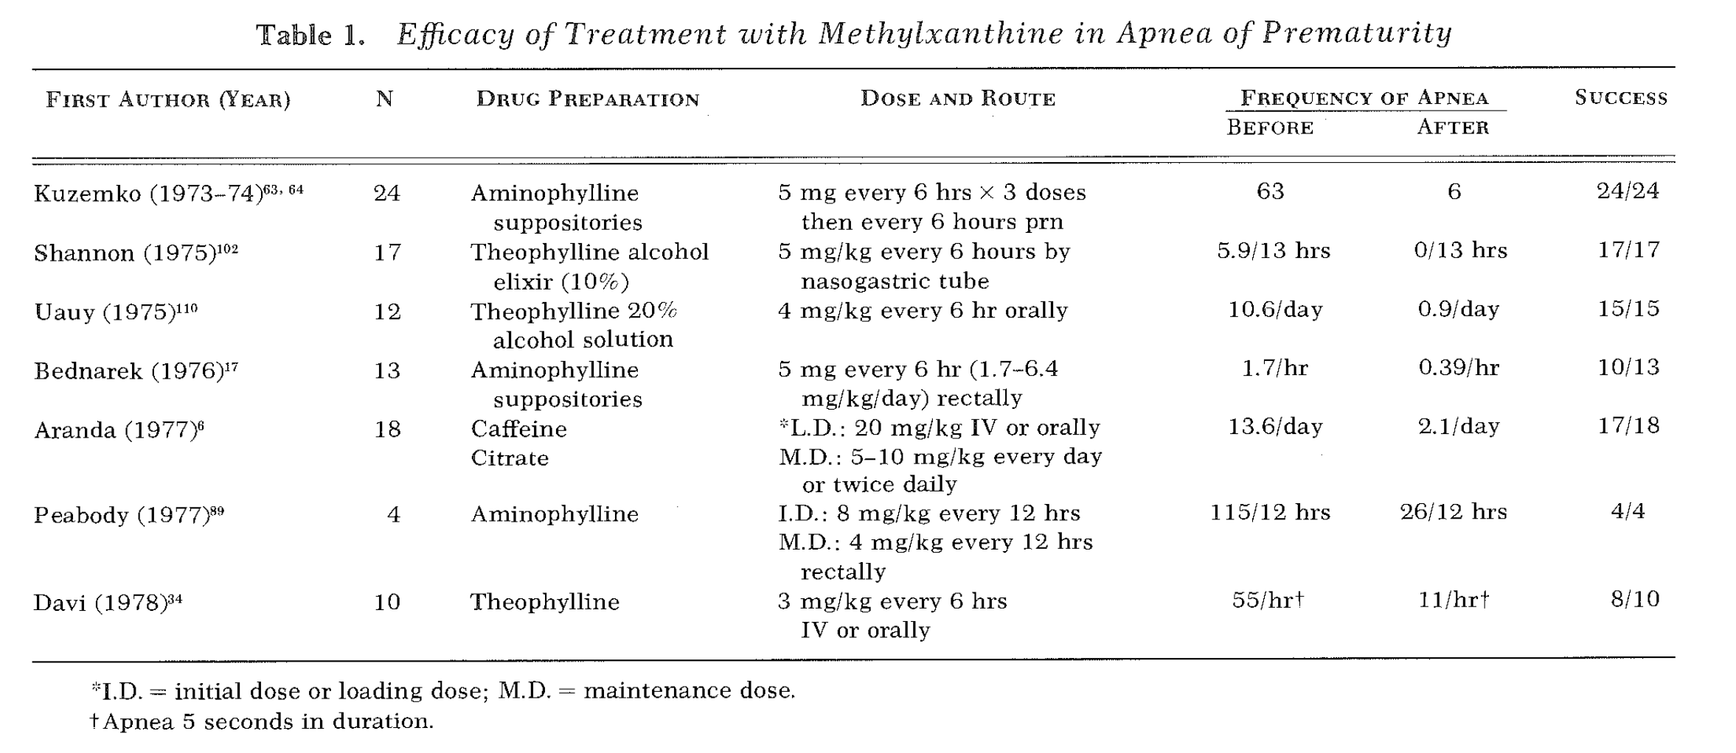
Modified from Aranda et al. 1979
Notes:
This 1973 study was followed by other studies looking at aminophylline or theophylline for the management of apnea of prematurity. Most studies assessed 20 babies or less and they all noticed the same thing Kuzemko et al noticed… less apnea

Slide 10
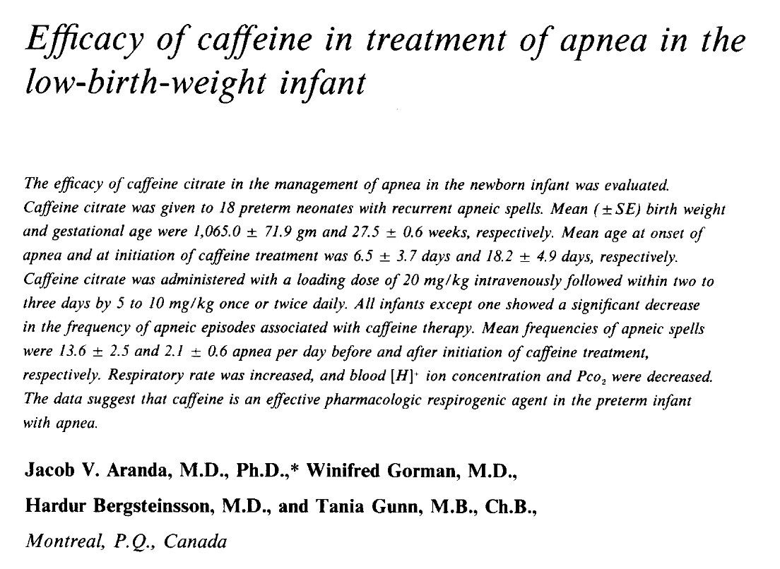
Aranda et al. 1977
Notes:
It would not be until 1977, that the first paper mentioning the use of caffeine for the treatment of prematurity would be published. It came out in the Journal of Pediatrics and was from first author Jacob Aranda. This was a group from Montreal, Canada that also included Winifred gorman, Hardur Bergsteinsson and the uber famous Tania Gunn (first to try therapeutic hypothermia for HIE… but that’s a discussion for another time).

Slide 11
Aranda et al. 1977
Notes:
It would not be until 1977, that the first paper mentioning the use of caffeine for the treatment of prematurity would be published. It came out in the Journal of Pediatrics and was from first author Jacob Aranda. This was a group from Montreal, Canada that also included Winifred gorman, Hardur Bergsteinsson and the uber famous Tania Gunn (first to try therapeutic hypothermia for HIE)
So, in 1977, the studies using theophylline and aminophylline pointed at the fact that apnea of prematurity must have been in part caused by failure or immaturity of central regulation of respiration. In line with this reasoning, caffeine, another methylxanthine, a more potent central respirogenic agent with less peripheral effects than theophylline was thought as a potential effective agent in the management of apnea of prematurity.

Slide 12
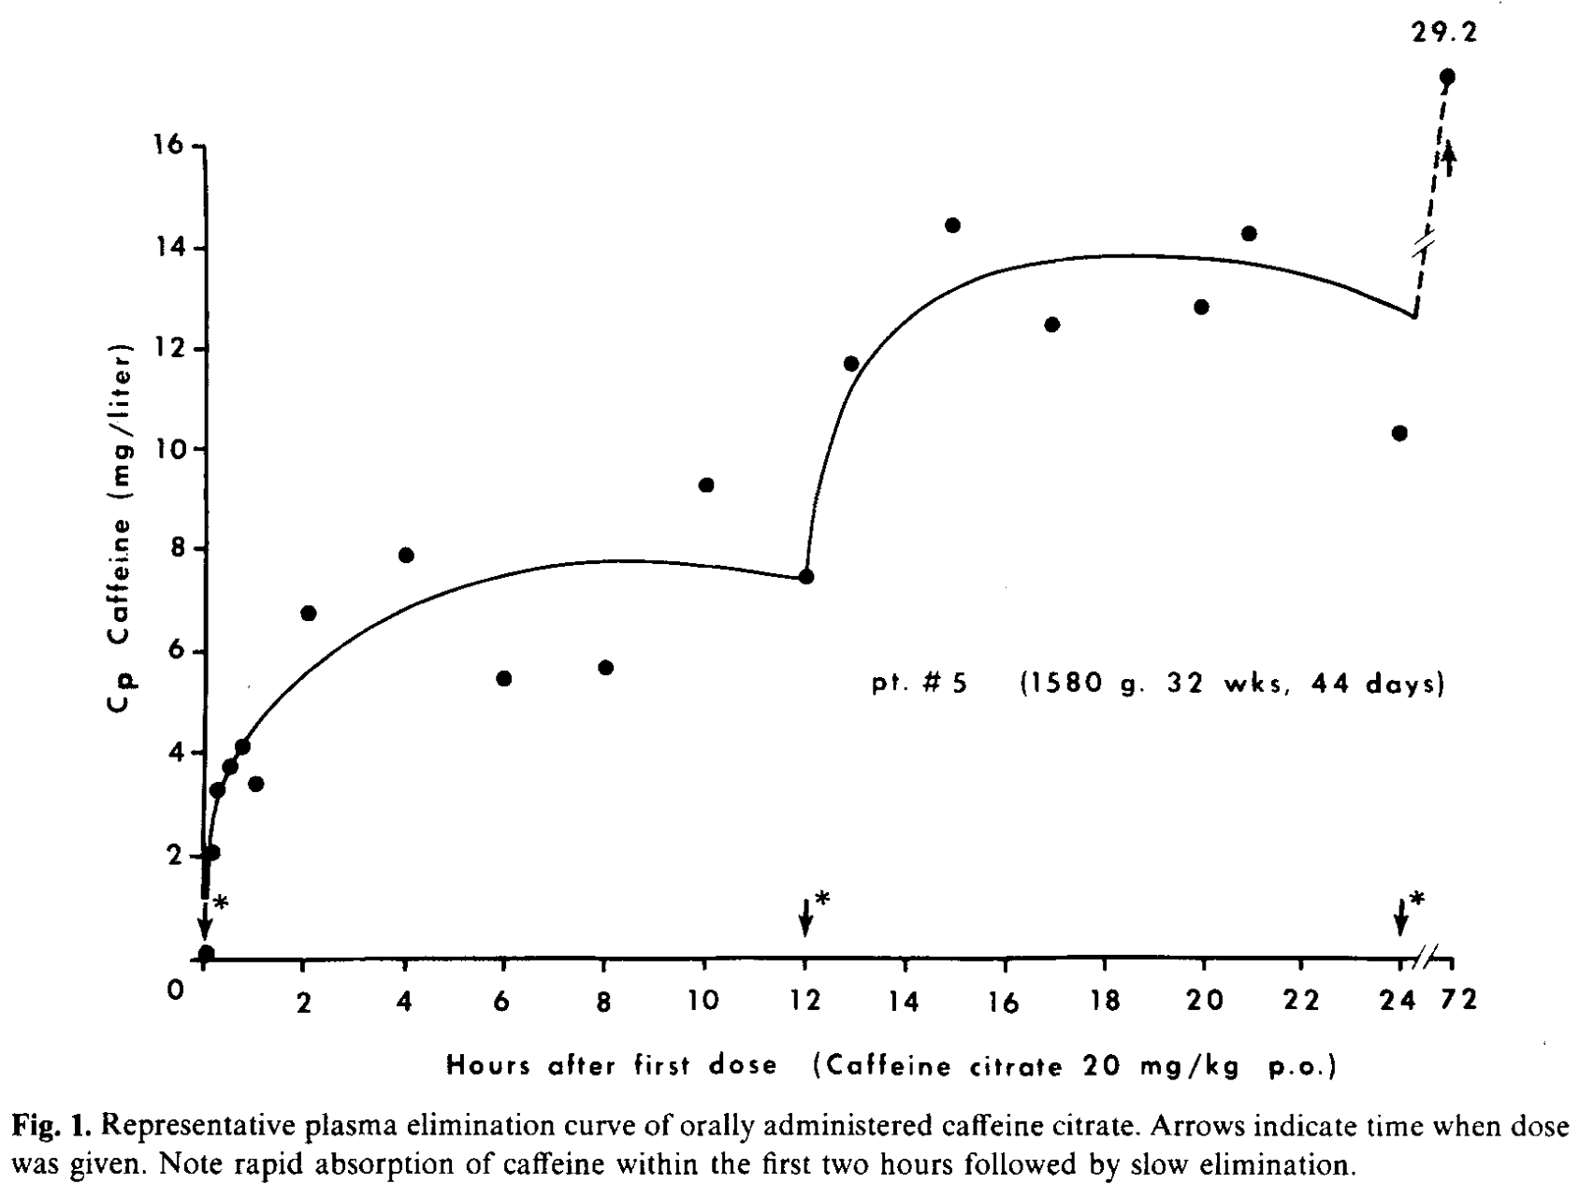
Aranda et al. 1977
Notes:
They studied eighteen low birth weight infants with a mean GA of 27.5 wks and a mean BW of 1065g. They initially administered 20mg/kg/dose of caffeine once to three times per day and followed plasma concentrations of caffeine and noticed that this lead to excessively high levels of plasma caffeine. So they changed their protocol to a loading dose of 20mg/kg IV followed by a maintenance dose of 5-10mg/kg once to twice per day).
FIGURE: y-axis = plasma concentration of caffeine, x-axis – hours after first dose.

Slide 13
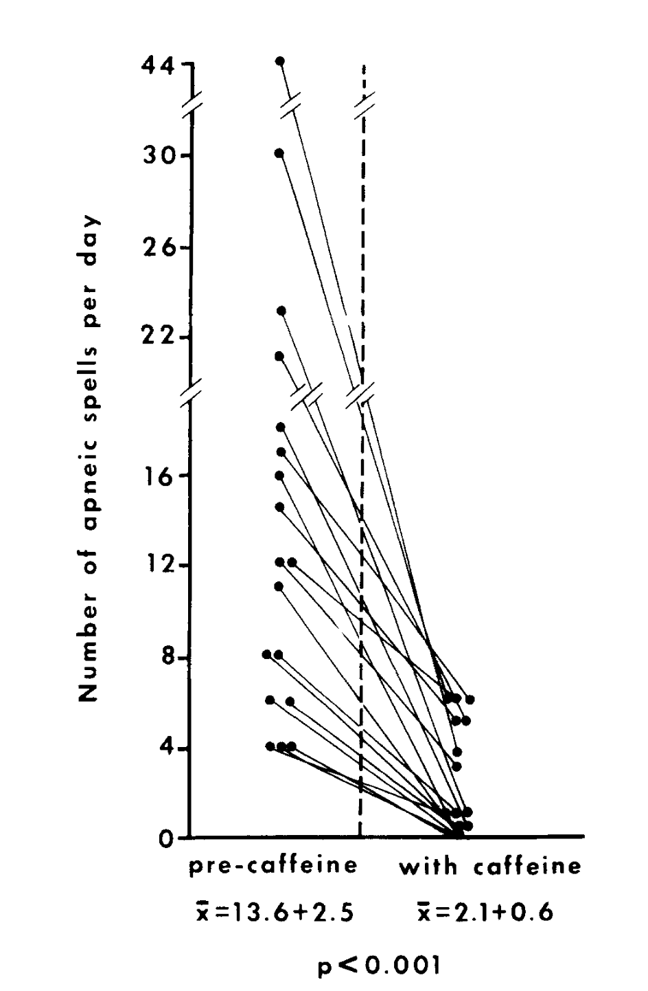
Aranda et al. 1977
Notes:
With this regimen they noticed a decrease in the frequency of apneic spells from ˜14 per day to ˜2 per day.
Figure: Y-axis = number of apneic spells per day
X-axis – before/after caffeine

Slide 14
Caffeine soon became favored by clinicians thanks to a reduced side effect profile compared to theophylline.
Notes:
From then on, many papers were published looking at theophylline and caffeine to treat and prevent apnea of prematurity. What transpired from the evaluation of theophylline vs caffeine had to do with the toxicity of these medications. Theophylline has significant side effects that include tachycardia, jitteriness, irritability, vomiting, abdominal distention and feeding intolerance, seizures, hyperglycemia, and electrolyte disturbance. At higher serum levels seizures can often be seen. The narrow therapeutic window of theophylline made caffeine a more palatable choice.
For one, caffeine is more potent because it penetrates into the CSF more readily and is thus a more potent centrally acting respiratory agent. It has a much longer half life than theophylline (8hrs vs 103hrs) and its side effects are minimal unless you reach ridiculously high plasma concentration. Also important to note, a mixed standardized solution of caffeine became available in 1999.
And so, despite theophylline being a favored agent in the US, the 80’s and 90’s saw the rise of caffeine as the more convenient, safer, and more effective agent to treat apnea of prematurity

Slide 15
A large trial studying the long term effects of caffeine in preterm infants was missing…

Slide 16
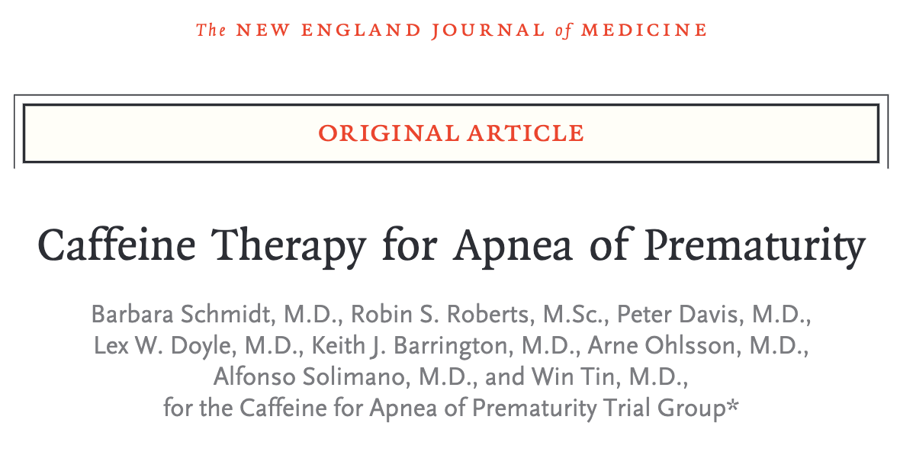
Schmidt et al. 2006
Notes:
What’s the question?
How safe are methylxanthines? Since the data was published many people are
using them for extended periods of time and we have no idea whether there are
Long term side effects that we should be aware of.
Study Design: This was a prospective multinational double blind randomized control trial
Inclusion Criteria: Birth weight 500-1250g during the first 10 days of life.
Exclusion Criteria: congenital anomalies, likely to be lost to follow up, previous caffeine treatment, unknown reasons.
Intervention:
IV loading dose of 20mg/kg followed by daily maintenance of 5mg/kg daily.
if apneas persisted, daily dose could be increased to 10mg/kg/day.
Blood serum caffeine levels were NOT measured during the study.
Caffeine could be discontinued at any time by the clinician.
Primary outcome: Composite outcome of neurodevelopmental impairment at 18-21mo of age
Secondary outcome: Short term secondary outcomes of BPD, IVH, NEC, ROP and growth

Slide 17
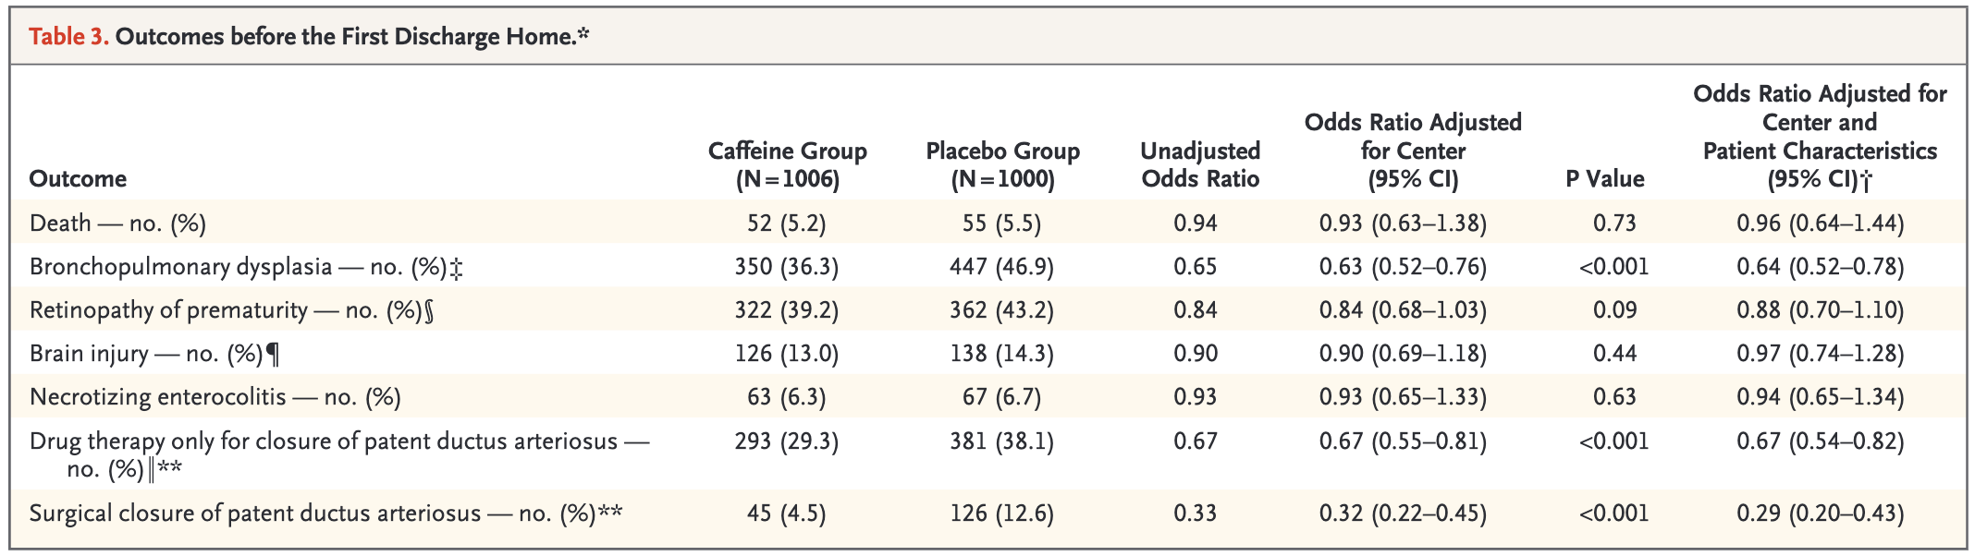
Schmidt et al. 2006
Notes:
Baseline characteristics:
They enrolled 2006 infants, 1006 in the caffeine group and 1000 in the placebo
arm. Mean GA was ˜27 weeks, mean BW ˜˜750-800g. Median age at randomization
3 days. Median GA at discontinuation – 34 weeks! Caffeine toxicity was found in only
1.8% of infants and lead to discontinuation of the medication.
Primary outcome:
See next slides….
Secondary outcomes:
They noted that babies in the caffeine group were weaned off invasive mechanical ventilation and o2 supplementation sooner. They also received less of postnatal steroids, and PRBC transfusion.
Less BPD! 47% > 36% p<0.001
Other outcomes (death, ROP, NEC, IVH) did not differ significantly bw groups. But at 18-22 mo less severe ROP was seen in the caffeine group.
No significant difference in growth outcomes.
Other interesting results
In post hoc analysis caffeine babies were less likely to need PDA intervention

Slide 18
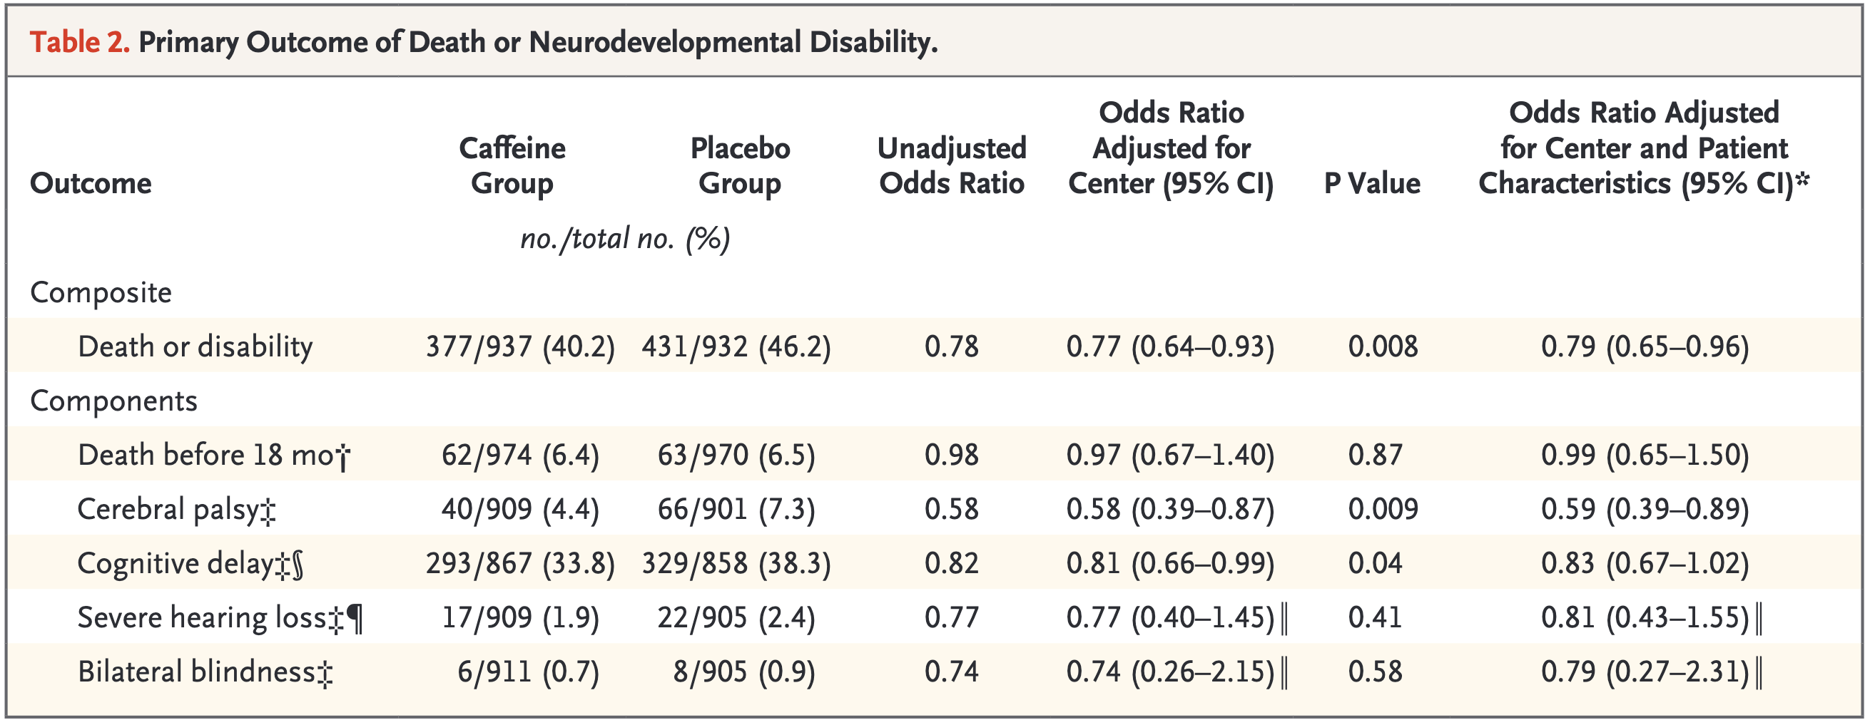
Schmidt et al. 2007
Notes:
Primary outcome:
The neurodevelopmental outcomes were published in the NEJM one year later
(2007) . Caffeine improved significantly the rates of survival at 18-22mo
without neurodevelopmental impairment. Reduction from 46% > 40% p=0.008
Number needed to treat was 16. No significant difference in the death at 18 mo
between groups. Incidence of CP was significantly lower 7.3% > 4.4% p=0.009 and
so was cognitive delay 38.3% > 33.8% p=0.04.

Slide 19
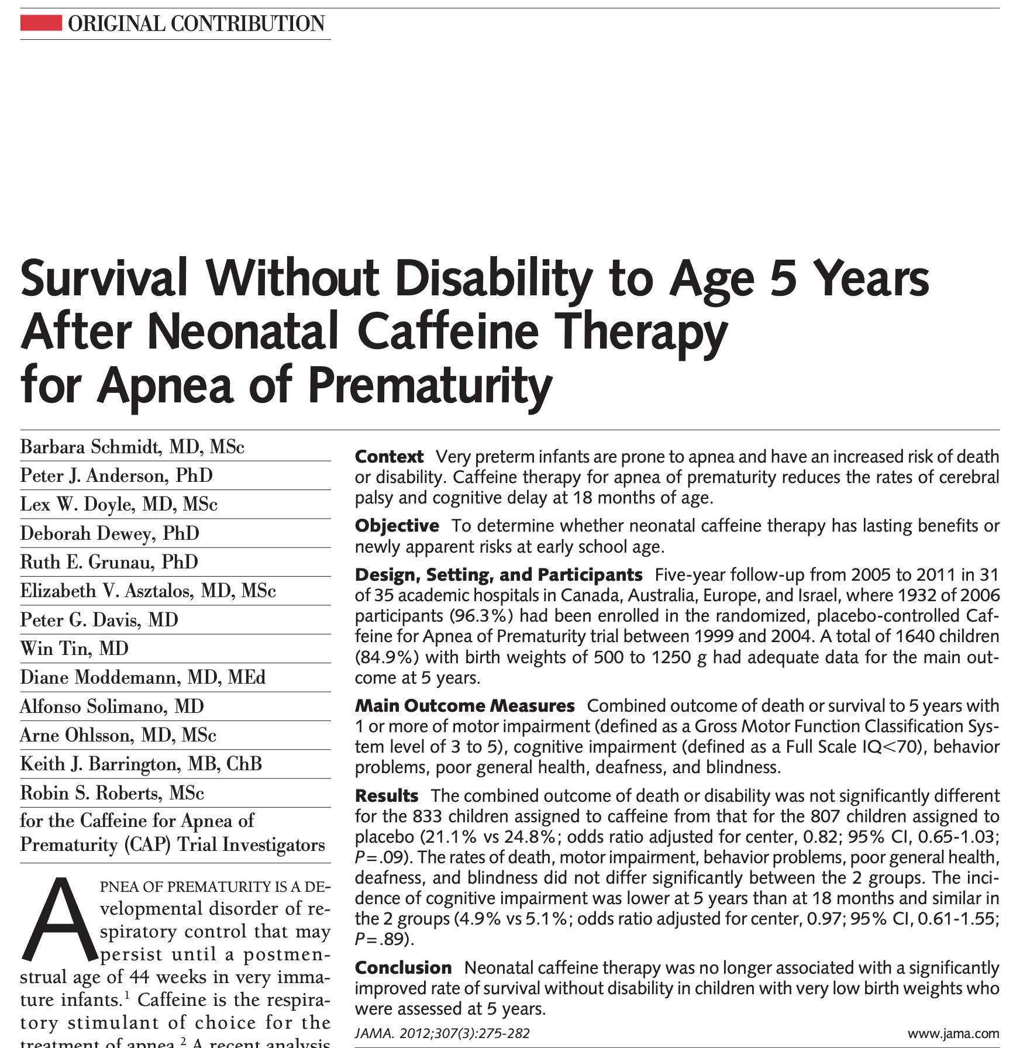
Schmidt et al. 2011
Notes:
Outcomes at 5years were no longer significant for improved survival w/o NDI in the caffeine group. They had lost a small number of babies, but the rates
of death or NDI were 24.8% vs 21.1%. Individual measures of NDI did not differ between
groups

Slide 20
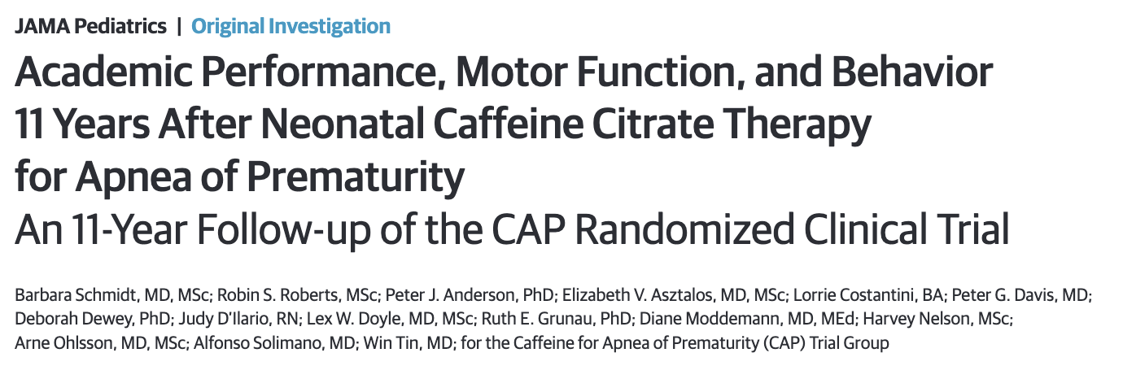
Schmidt et al. 2011
Notes:
Outcomes at 11yo: Caffeine did not reduce significantly the combined rates of academic motor, and behavioral impairments but was associated with a reduced risk of motor
impairment in 11yo children with very low birth weight.

Slide 21
Understanding the mechanism of action of caffeine requires an understanding of how preterm infants regulate their breathing

Slide 22
Apnea of prematurity is defined as the cessation of breathing for >15s and is typically accompanied by bradycardia and/or desaturation.

Slide 23
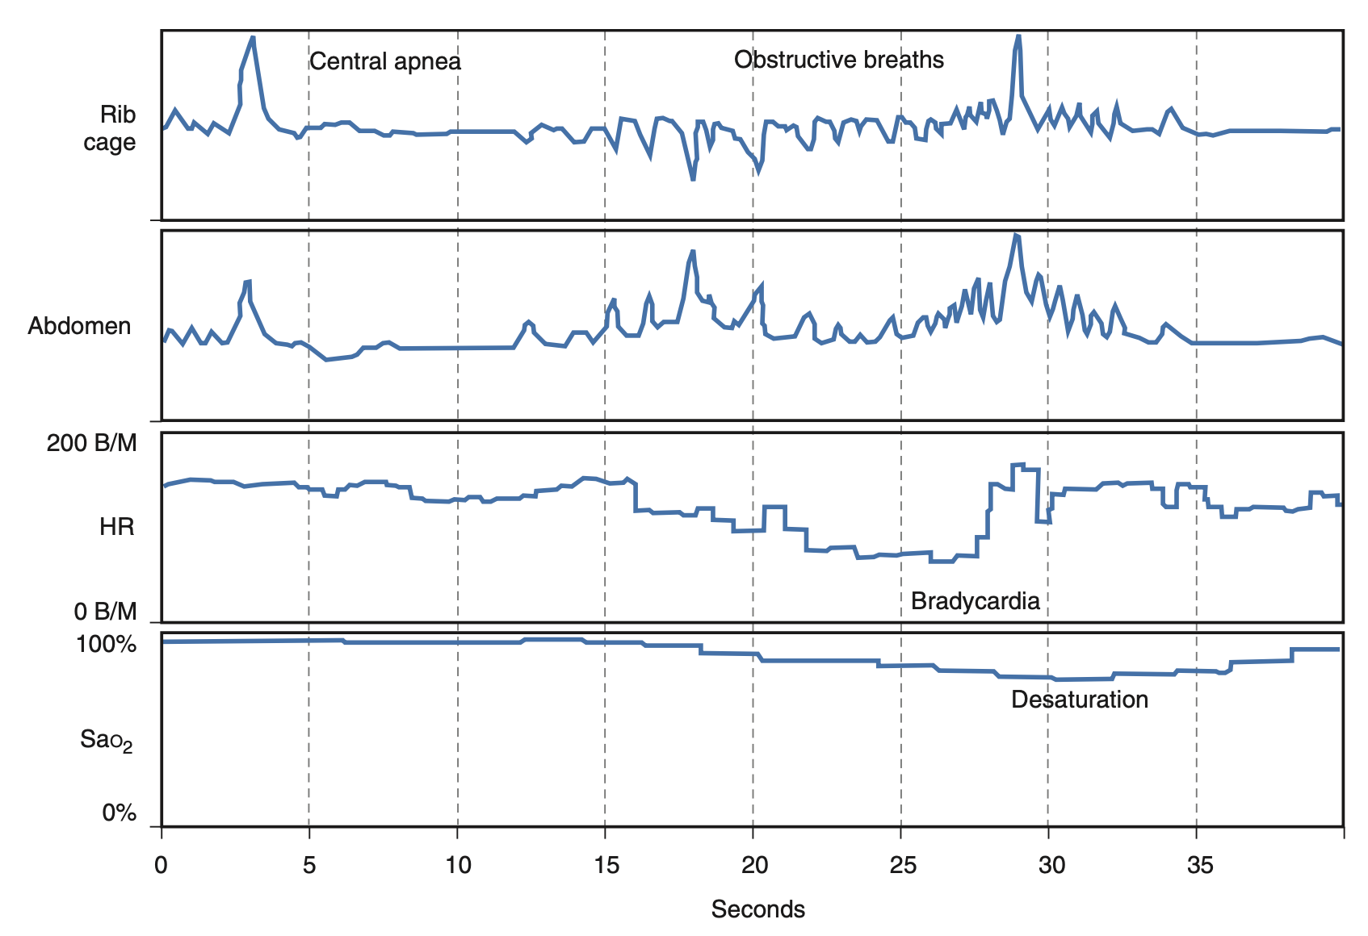
Credit: fanaroff and martin's neonatal-perinatal medicine 11th ed.
Notes:
Characteristic mixed apnea of approximately 20 seconds’ duration commencing with a central component and prolonged by obstructed inspiratory efforts. In the absence of simultaneous measurement of rib cage and abdominal motion, as occurs during routine impedance monitoring, the inspiratory efforts are not recognized as obstructed. As noted in this tracing, bradycardia and desaturation are secondary to the cessation of effective ventilation during the mixed apnea. B/M, Beats per minute; HR, heart rate; SaO2, arterial oxygen saturation.

Slide 24
CENTRAL
OBSTRUCTIVE
MIXED
Notes:
Apnea is traditionally classified into 3 categories: central, obstructive, or mixed.
The exact mechanism of apnea of prematurity is still not known.
We now understand that multiple factors play a role, and that AOP is really a mix of central and peripheral apnea, so obstruction plays a role. Obviously, this is not modified by caffeine.

Slide 25
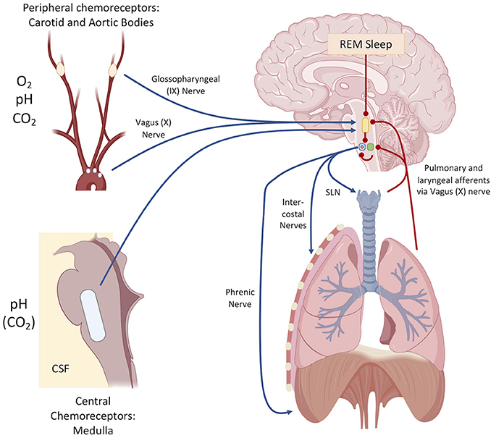
Williamson et al 2021
Notes:
Peripheral:
carotid body immaturity- Carotid body chemoreceptors are sensors of arterial O₂, CO₂, and pH
laryngeal chemoreflex- when the laryngeal mucosa is irritated by any substance, an inhibition of breathing is mediated by the superior laryngeal nerve. In animal studies this reflex is more prominent in preterm animals compared to term animals (Martin et al).
excessive bradycardic response
Central:
delayed central nervous system development
decreased central chemosensitivity, so there is a decreased ventilatory response to hypercarbia where in the face of elevated CO2, infant increase tidal volume instead of respiratory rate.
hypoxic ventilatory depression: i.e hypoxia leads to ventilatory depression, the role of this mechanism is unclear because frequently apnea precedes hypoxia.
Adenosine is an upregulated inhibitory neurotransmitter which plays a role in inhibiting the phrenic and hypoglossal nerve.

Slide 26
What is the mechanism of action of caffeine?
☕️
Notes:
Overall it increases minute ventilation, increases metabolic rate; and increases oxygen consumption.

Slide 27
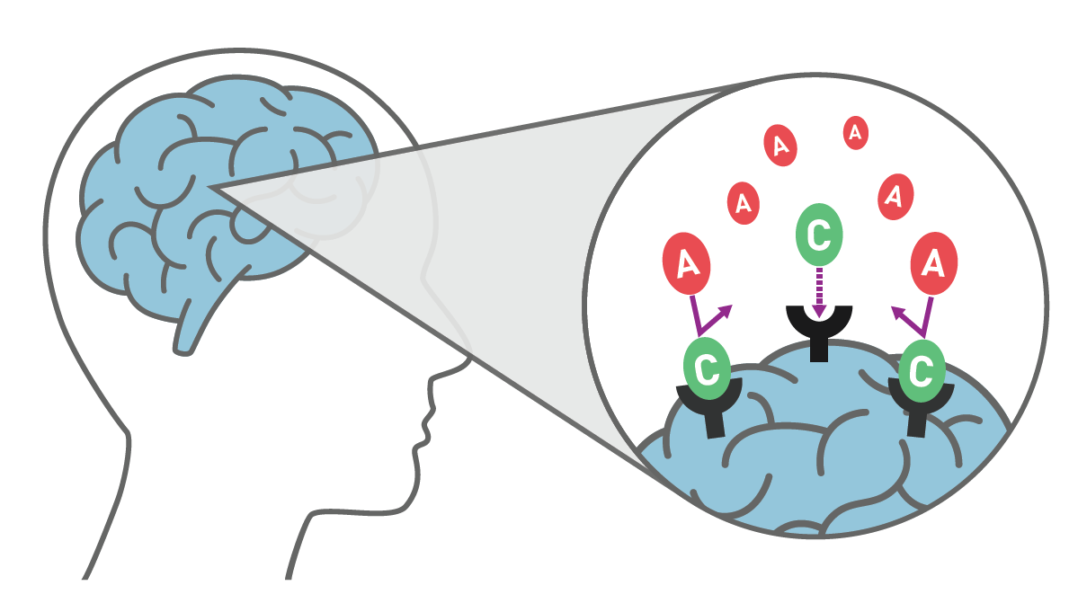

Notes:
1. Adenosine receptor antagonist: Adenosine receptors in the basal forebrain are essential in signaling fatigue to the brain as adenosine accumulates the longer one stays awake. Methylxanthines bind these receptors, instead of adenosine, and this antagonism is the drug’s primary means of CNS stimulation.
2. Methylxanthines also increase calcium uptake via adenosine-mediated calcium channels in the diaphragm, increasing diaphragmatic contraction and have an effect on increased skeletal muscle tone.

Slide 28
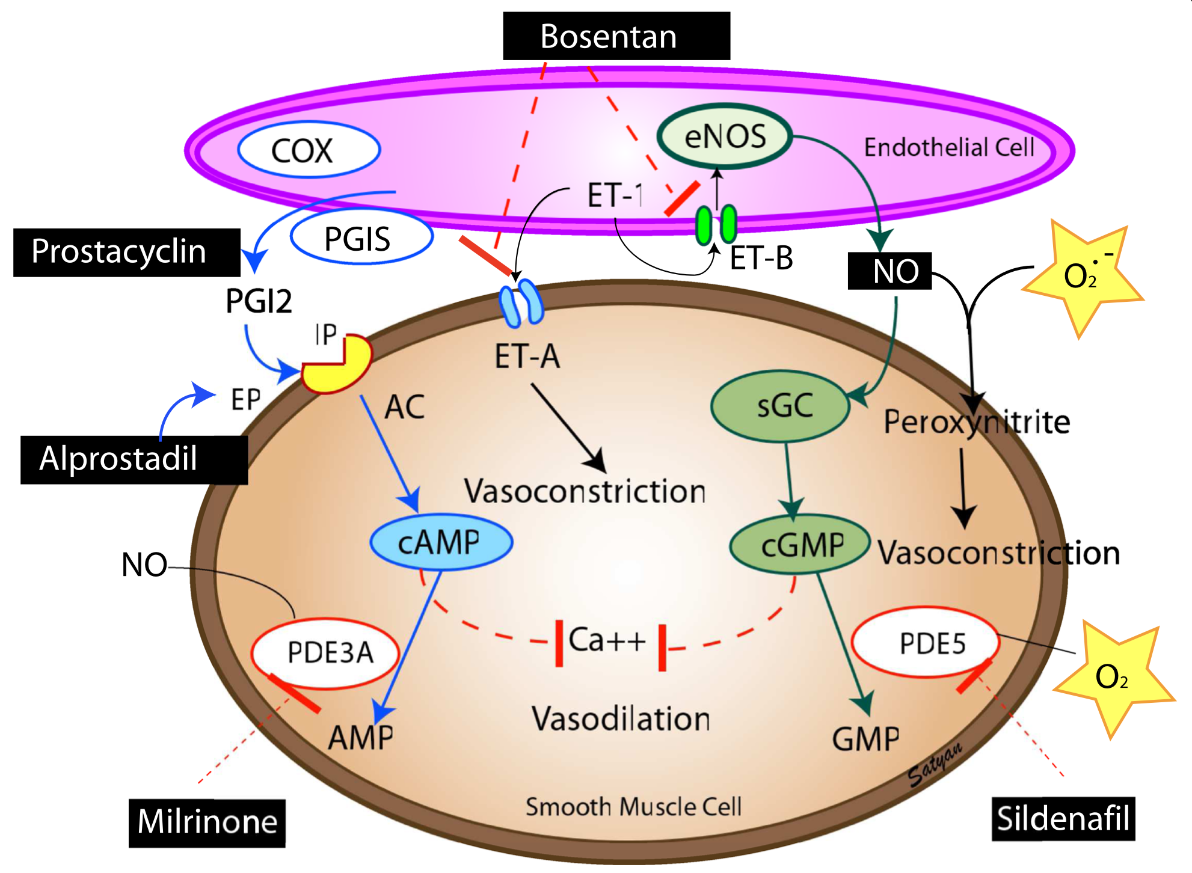
Sharma et al 2015
Notes:
3. Phosphodiesterase inhibitor. cause an intracellular increase in levels of cyclic adenosine monophosphate (cAMP) and cyclic guanosine monophosphate (cGMP)- much like sildenafil and milrinone (but that’s a discussion for another episode). This signal results in bronchial smooth muscle relaxation, pulmonary vessel vasodilation, diuresis, CNS stimulation, and cardiac stimulation.

Slide 29
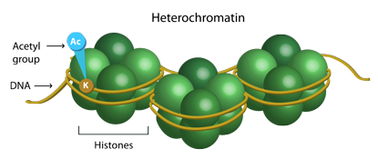
Notes:
4. Histone deacetylase activator: Increased recruitment of histone deacetylase to areas of inflammation prevents the transcription of genes for inflammatory mediators and thus exerts an anti-inflammatory effect.

Slide 30
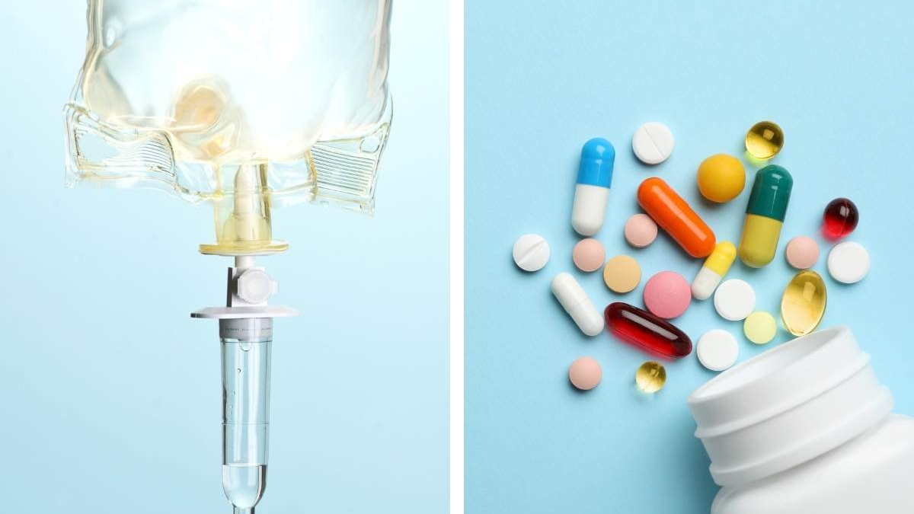
Notes:
The route of administration of caffeine does not affect its pharmacokinetics and thusly, there is almost complete bioavailability after its administration orally or intravenously. Caffeine is absorbed rapidly from the gastrointestinal tract with minimal-to-no first pass metabolism, and its peak plasma concentrations frequently occur in less than one hour, which is useful to know because if you think apnea is related to low caffeine levels, you should improvement pretty quickly after administration of a caffeine loading dose. It is rapidly distributed into the brain, and in preterm infants the levels of caffeine in the cerebro-spinal fluid approximate the plasma levels.
Transformation of caffeine occurs in the liver and it is affected by the P450 system and so it’s metabolism in the preterm infant is limited by immaturity of the hepatic enzymes. The caffeine half-life may be prolonged further in exclusively breastfed infants and infants with cholestatic jaundice. In the first weeks of life, caffeine is eliminated mainly by renal excretion and so elimination is slower in the premature and term neonate, compared with older children and adults, because of renal immaturity.
Drugs like ketoconazole and cimetidine inhibit caffeine metabolism and drugs like phenytoin and phenobarbitone, on the other hand induce caffeine metabolism so dosing may need to be adjusted if there is concomitant use of these medications.
Signs of toxicity, seen at levels of 40-50 include: Tachycardia, cardiac failure, pulmonary edema, hypertonia, sweating, metabolic disturbances.
Caffeine levels can be measured in plasma, saliva or urine and some studies have even used dried blood spots (DBS). So it’s hopeful that we could have more invasive ways to monitor levels.

Slide 31
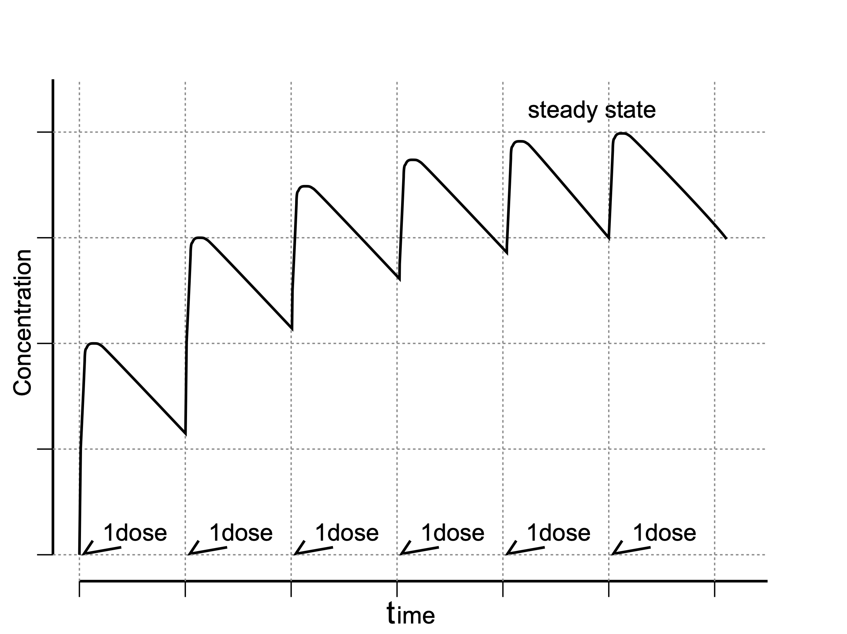
Notes:
Approximately 5 half-lives is the time needed to reach steady state. Conversely, if a drug is in a steady state, 5 half-lives are needed to eliminate it from the body after intake has stopped. Caffeine is a methylxanthine that has a long half-life – close to 50 hours in a preterm infant. Therefore, the time to eliminate caffeine from the body will be close to 7 days.

Slide 32
In preterm infants born prior to 28 weeks’ gestation, apnea of prematurity can often last beyond 40 weeks’ postmenstrual age.
Notes:
Prior to discharging a preterm infant who had been treated with caffeine, the clinician must make sure that apnea does not recur after cessation of caffeine therapy. This would be possible only after observing this infant for at least 7 days after cessation of caffeine therapy. To facilitate discharge, the decision to discharge some infants with persistent apneic events to home with monitoring may be an option if the events are low in severity. Although the infant in this vignette is not having any such episodes, he needs to be observed until the caffeine has been eliminated from his body. If he remains free from apneic events, he will not require home monitoring.

Slide 33
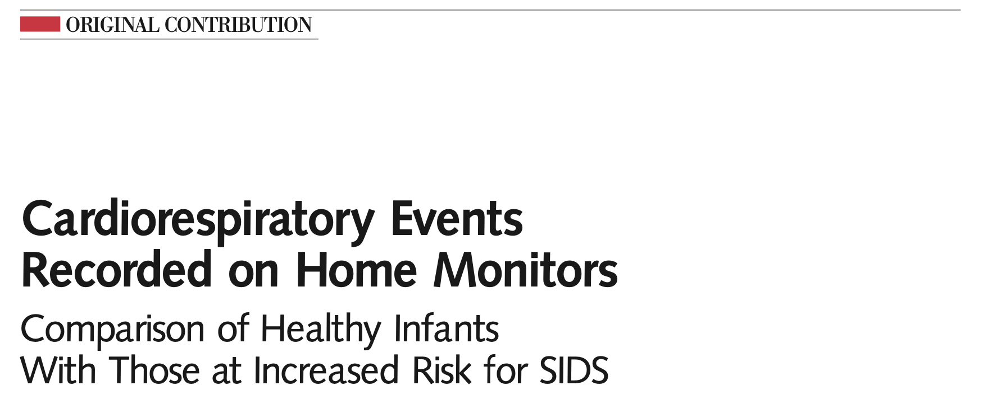
Ramanathan et al 2001
Notes:
The CHIME study in JAMA in 2001 showed that infants with a history of AOP who exhibited apnea-related symptoms within the last 5 days prior to NICU discharge had a higher relative risk of at least one extreme event at home compared to those who had no clinically apparent apnea-related events for ≥5 days before discharge.

Slide 34
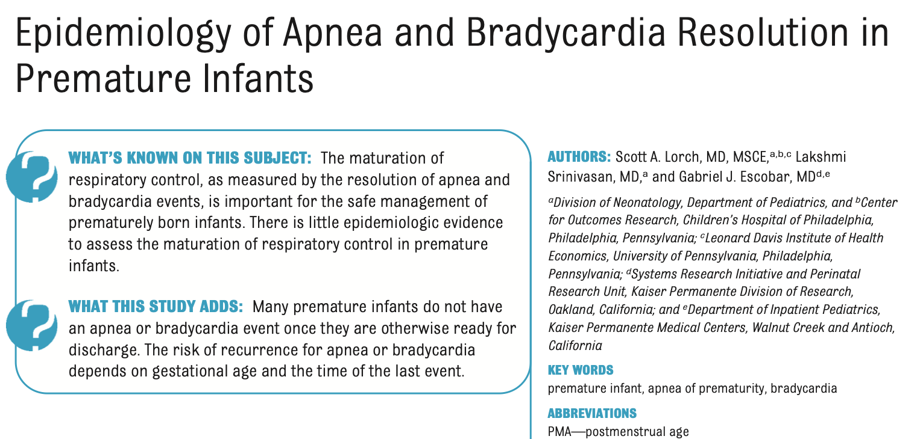
Lorch et al 2011
Notes:
What’s the question?
To measure the the percentage of infants who have no additional events of various apnea- or bradycardia-free intervals after correcting for gestational age, postmenstrual age of the last apnea or bradycardia event, and the severity of the event.
Study design: retrospective cohort study of data collected within the Kaiser Permanente Medical Care Program (KPMCP) between 1998 and 2001 during the Infant Functional Status Study, as described previously. The goal of the Infant Functional Status Study was to assess discharge decision making for premature infants
Inclusion criteria: Eligible infants were born at 5 KPMCP hospitals between 1998 and 2001 with a gestational age of 34 weeks or less.
Exclusion criteria: major congenital anomalies, the need for home mechanical ventilation, ventriculoperitoneal shunt placement, and loss to follow-up within 1 year of discharge. Approximately 20% of eligible infants were excluded. Excluded infants were older and heavier at birth and more likely to be black or Hispanic than the included infants. The included and excluded infant groups were similar in their need for mechanical ventilation and their average length of NICU stay.
Primary Outcome: success rate and event identification rate (EIR) of various apnea- and bradycardia-free intervals. We first determined the day when a child was classified as being ready for discharge: No feeds administered via a naso- or orogastric tube, Temperature maintained off of supplemental heat, Receipt of nasal cannula oxygen or room air, Discontinuation of methylxanthines. Then, the day when the last apnea or bradycardia event occurred before this ready-for-discharge day was identified and included all subsequent days in our analysis.
Secondary Outcomes: For the second aim of the study, they calculated the success rate and EIR of each apnea- or bradycardia-free interval after stratifying by the gestational age of the infant or the PMA of the last apnea or bradycardia event. For the third aim of the study, they calculated the success rate and EIR of each apnea- or bradycardia-free interval using only severe apnea or bradycardia events. Then, the team reran all analyses after requiring that methylxanthines be discontinued for 3 and 5 days, on the basis of the half-life of these medications.

Slide 35
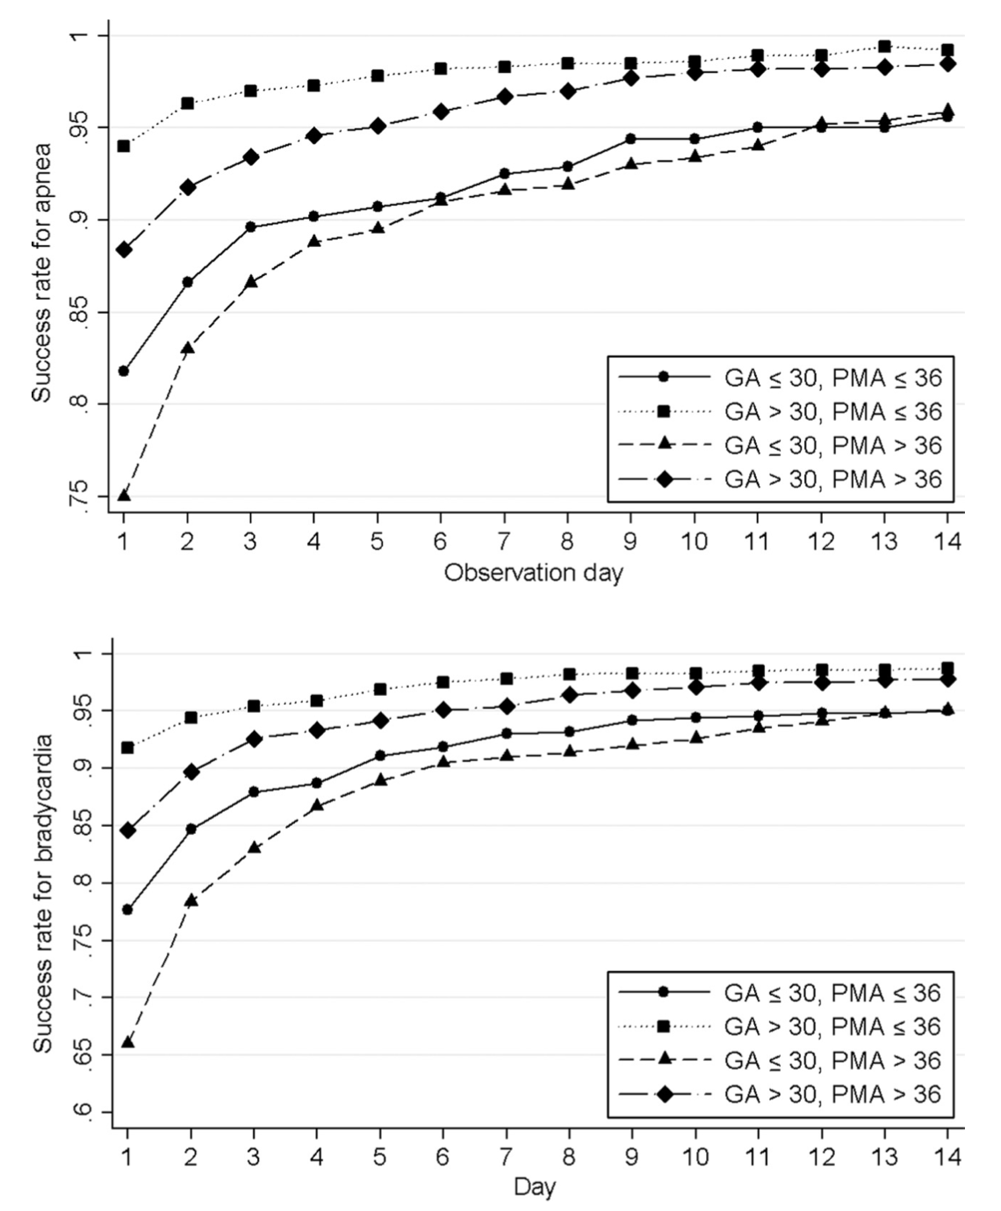
Lorch et al 2011
Notes:
Primary Outcomes: Once the infants were otherwise ready for discharge, 84.2% did not have an apnea event and 78.5% did not have a bradycardia event. 94% did not have a serious apnea event and 93% did not have a serious bradycardia event. These infants tended to be larger and less likely to have complications of premature birth compared with infants with a future event. Such that as GA increased infants were less likely to have future events. Babies were more likely to have future events if discharged on oxygen or had BPD.
Secondary outcomes: They looked at each length interval from 1 day to 14 days. A 95% success rate apnea threshold was not reached until 13 days for infants with a gestational age of less than 26 weeks, 9 days for infants with a gestational age of 27 to 28 weeks. In contrast, infants of a gestational age of 30 weeks or more reached this threshold between 1 and 3 days after the last apnea event.
Bradycardia showed similar trends. Beginning the observation time after a PMA of 36 weeks reduced the success rate by 5% to 10% regardless of the gestational age of the infant, compared with a PMA of 36 weeks or less. Infants of younger gestational age had, on average, an older PMA for their last event than older–gestational age infants.

Slide 36
In summary:
The exact mechanism of apnea of prematurity is still not known.
Methylxanthines, including caffeine and theophylline, can treat and prevent apnea of prematurity
Caffeine has been favored since the 1980s due to its safety profile
Caffeine has been shown to also reduce rates of BPD and severe ROP in preterm infants
Compared to placebo, caffeine reduced rates of death/disability at 18-22mo
Caffeine also reduced cognitive impairment and rates of cerebral palsy at 18-22mo
Infants should be monitored for 7 days after discontinuation of caffeine prior to discharge from the NICU
Infants born at lower GA have a higher risk of recurrent apnea/bradycardia after discharge
Still needs investigation: timing of caffeine initiation, when to discontinue caffeine, high vs low dose, AI use to predict severe apnea events during and after NICU hospitalization

Slide 37

Thank You

